Slide 1
Red black tree
Session 27-28
Anang Prasetyo, S.Kom., M.Kom.

Slide 2
Learning outcomes
At the end of this session, students will be able to:
LO 1: Explain the concept of data structures and its usage in Computer Science
LO 2: Illustrate any learned data structure and its usage in application

Slide 3
Subtopics
RBT Concept & Application
RBT Properties
RBT Operation Insert Delete

Slide 4
RBT Concept & Applications
Concept
In computer science, a red–black tree is a specialized binary search tree data structure noted for fast storage and retrieval of ordered information.
The nodes in a red-black tree hold an extra bit called "color" representing "red" and "black" which is used when re-organizing the tree to ensure that it is always approximately balanced.

Slide 5
RBT Concept & Applications
Applications
Red Black Trees offer worst case time guarantee for insertion, deletion, and search operations
Red Black Trees are not only valuable in time-sensitive applications such as real-time applications
Red Black Trees are preferred to be used as a building block in other data structures which provide worst-case guarantee
Real-world uses of red-black trees include TreeSet, TreeMap, and Hashmap in the Java Collections Library.
Also, the Completely Fair Scheduler in the Linux kernel uses this data structure.
Linux also uses red-black trees in the mmap and munmap operations for file/memory mapping

Slide 6
RBT properties
A binary search tree is a red black tree if:
Every node has a color, either red or black.
Root is black by default.
All external nodes are black.
If a node is red, then both its children are black.
The 4th property implies that:
There is no red node has a red parent.
Every simple path from a given node to any of its descendant external nodes contains the same number of black nodes.

Slide 7
RBT OPERATION
INSERTION
Insert a new node just like inserting in binary search tree (it should be located in one of the external nodes)
That new node is red
Fix any red black tree violation
If the parent is black, then no violation occurred.
If the parent is red, then violation occurred (no red node has red parent).

Slide 8
RBT OPERATION
INSERTION
Fixing the violation
Let the new node be q, its parent be p, and sibling of parent be s (uncle of q). If parent doesn’t have sibling, then s is black (an external node is black).
If s is red, then change p and s to black and parent of p to red (recolor).
If s is black, do rotation (single or double), change the last rotation pivot be black and their child be red.

Slide 9
RBT OPERATION
INSERTION
The new inserted node is X.
X’s parent is black, so no violation occurred.

Slide 10
RBT OPERATION
INSERTION
The new inserted node is X (or Z in the right picture).
Its parent is red, so violation occurred.
Its uncle (sibling of its parent) is red, so change its parent and its uncle to black and change its grandparent to red (Recolor).

Slide 11
RBT OPERATION
INSERTION
The new inserted node is X (or Z in the right picture).
Its parent is red, so violation occurred.
Its uncle (sibling of its parent) is black and path to its parent is the same with path to its grandparent (left-left or right-right), so single rotate at its grandparent
Change its parent to black and its sibling (ex-grandparent) to red.

Slide 12
RBT OPERATION
INSERTION
The new inserted node is X (or Z in the right picture).
Its parent is red, so violation occurred.
Its uncle (sibling of its parent) is black and path to its parent is different with path to its grandparent (left-right or right-left), so double rotate at its parent and at its grandparent (just like in AVL tree).
Change the last rotation pivot to black and their children to red.

Slide 13
RBT OPERATION
INSERTION EXAMPLE
Insert: A L G O R I T H M
A
A
A is root,
so it’s painted BLACK

Slide 14
RBT OPERATION
INSERTION EXAMPLE
Insert: A L G O R I T H M
A
L
L’s parent is black,
so no violation occurred.

Slide 15
RBT OPERATION
INSERTION EXAMPLE
Insert: A L G O R I T H M
A
G
double rotate
L
A
L
G
Its parent is red, so violation occurred.
Its uncle (sibling of its parent) is black and path to its parent is different with path to its grandparent (left-right or right-left), so double rotate at its parent and at its grandparent (just like in AVL tree).
Change the last rotation pivot to black and their children to red.

Slide 16
RBT OPERATION
INSERTION EXAMPLE
Insert: A L G O R I T H M
G
A
L
O
O’s parent is black,
so no violation occurred.

Slide 17
RBT OPERATION
INSERTION EXAMPLE
Insert: A L G O R I T H M
G
G
A
L
single rotate
O
A
O
R
L
R
Its parent is red, so violation occurred.
Its uncle (sibling of its parent) is black and path to its parent is the same with path to its grandparent (left-left or right-right), so single rotate at its grandparent
Change its parent to black and its sibling (ex-grandparent) to red.

Slide 18
RBT OPERATION
INSERTION EXAMPLE
Insert: A L G O R I T H M
G
G
A
O
change color
A
O
L
R
L
R
I
I
Its parent is red, so violation occurred.
Its uncle (sibling of its parent) is red, so change its parent and its uncle to black and change its grandparent to red.

Slide 19
RBT OPERATION
INSERTION EXAMPLE
Insert: A L G O R I T H M
G
A
O
L
R
I
T
T’s parent is black,
so no violation occurred.

Slide 20
RBT OPERATION
INSERTION EXAMPLE
Insert: A L G O R I T H M
G
G
A
O
A
O
single rotate
L
R
I
R
I
T
H
L
T
H
Its parent is red, so violation occurred.
Its uncle (sibling of its parent) is black and path to its parent is the same with path to its grandparent (left-left or right-right), so single rotate at its grandparent
Change its parent to black and its sibling (ex-grandparent) to red.

Slide 21
RBT OPERATION
INSERTION EXAMPLE
Insert: A L G O R I T H M
G
G
I
A
O
O
G
O
A
color change
double rotate
I
R
I
R
A
H
L
R
H
L
T
H
L
T
M
T
M
M
M’s parent is red, so violation occurred.
Its uncle (sibling of its parent) is red, so change its parent and its uncle to black and change its grandparent to red.
I’s parent is red, so violation occurred.
I’s uncle (sibling of its parent) is black and path to its parent is different with path to its grandparent (left-right or right-left), so double rotate at its parent and at its grandparent (just like in AVL tree).
Change the last rotation pivot to black and their children to red.

Slide 22
RBT OPERATION
DELETION
Perform similar DELETION process in BST
Either choose RIGHT-MOST of LEFT CHILD or LEFT-MOST of RIGHT CHILD

Slide 23
RBT OPERATION
DELETION
NODE-TO-DELETE : RED - NO VIOLATION
NODE-TO-DELETE : BLACK
DELETE the NODE
Mark the location as DOUBLEBLACK
SIBLING : RED
- Change PARENT to RED
- Change SIBLING to BLACK
- Rotate at X -> RECHECK DOUBLE BLACK
SIBLING : BLACK
1) BOTH CHILD : BLACK
- Change SIBLING to RED
- Move DOUBLEBLACK to PARENT -> RECHECK DOUBLEBLACK
2) One of the CHILD : RED
- SINGLE/DOUBLE ROTATION
- Change CHILD to BLACK -> REMOVE DOUBLEBLACK

Slide 24
RBT OPERATION
DELETION
Deleting a node is just like deleting in binary search tree
(if it is a node with two children, find the maximum element in its left sub-tree or minimum element in its right sub-tree).
Let the node to be deleted be M, and its child be C.
If M is red, then simply replace it with C
If M is black and C is red, replace it with C and recolor C with black.
What if M and C are black?

Slide 25
RBT OPERATION
DELETION
If M and C are black, replace M with C.
Let’s denote C in its new position be N (it’s also called a double black), its parent be P, its sibling be S, SL be S’s left child and SR be S’s right child.
If S is red, reverse the color of N and P, and rotate at P.
If S, SL and SR are black, then recolor S as red.
If S is black and SL or SR is red, then single rotate or double rotate.

Slide 26
RBT OPERATION
DELETION
a is a double black node,
its sibling is red so rotate at X and recolor X and Y.

Slide 27
RBT OPERATION
DELETION
a is a double black node,
its sibling is black and both its sibling children are black,
so recolor its sibling to red.

Slide 28
RBT OPERATION
DELETION
a is a double black node, its sibling is black and
one of its sibling’s children is red,
so do single/double rotation .

Slide 29
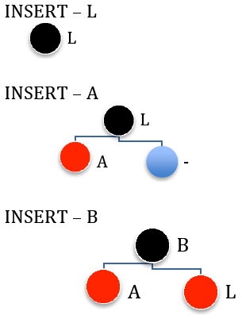
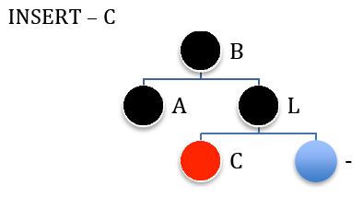
RBT OPERATION
INSERTION EXAMPLE
Inserting string “LABCOMPUTING” (1)

Slide 30
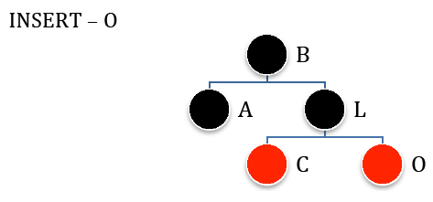
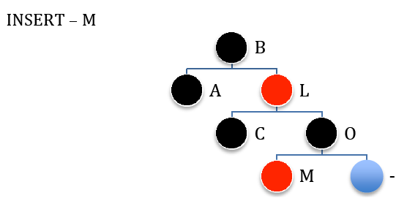
RBT OPERATION
INSERTION EXAMPLE
Inserting string “LABCOMPUTING” (2)

Slide 31
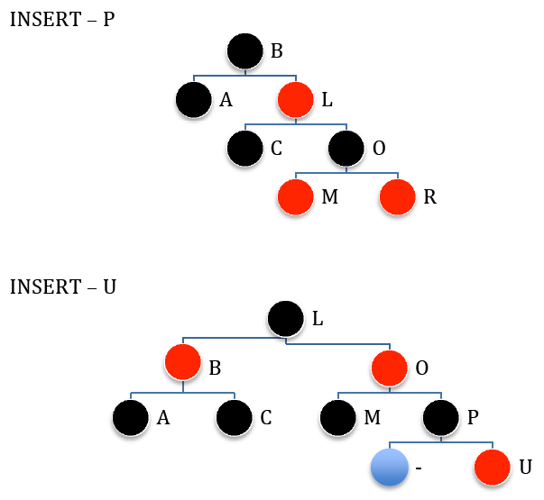
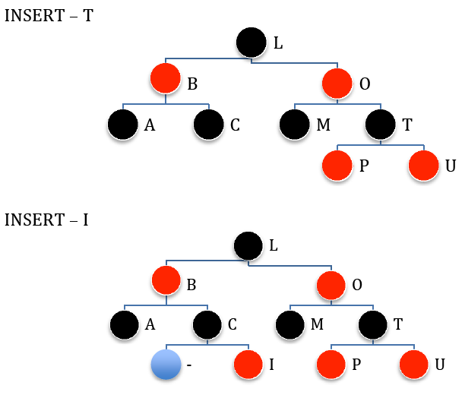
RBT OPERATION
INSERTION EXAMPLE
Inserting string “LABCOMPUTING” (3)

Slide 32
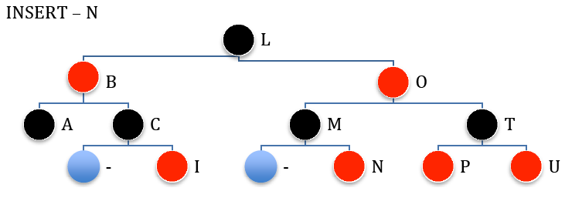
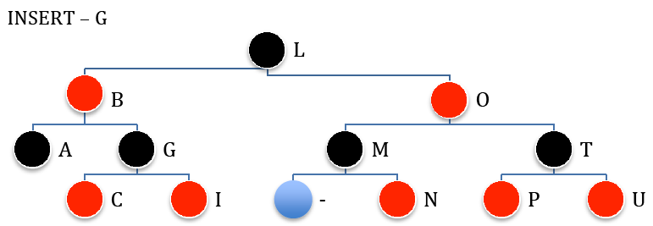
RBT OPERATION
INSERTION EXAMPLE
Inserting string “LABCOMPUTING” (4)

Slide 33
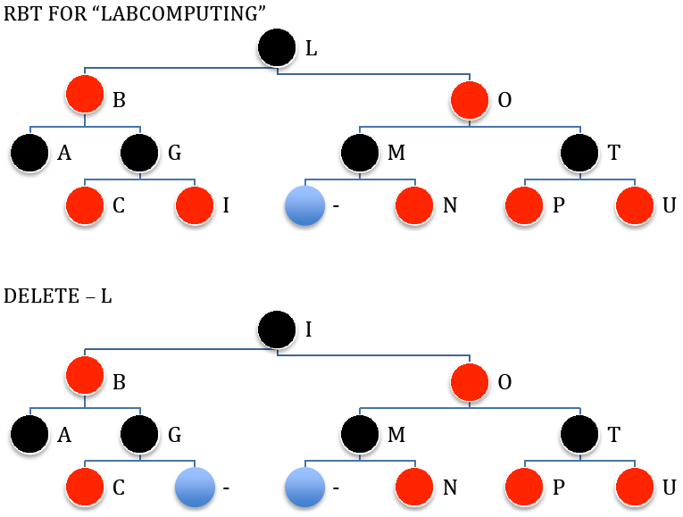
RBT OPERATION
DELeTION EXAMPLE
Deleting string “LABCOMPUTING” (1)
Deleting a node is just like deleting in binary search tree (if it is a node with two children, find the maximum element in its left sub-tree or minimum element in its right sub-tree).
Let the node to be deleted (L) be M, and its child (I) be C.
M is black and C is red, replace it with C and recolor C with black.

Slide 34
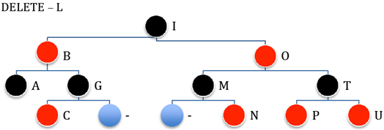
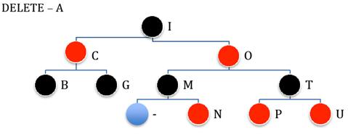
RBT OPERATION
DELeTION EXAMPLE
Let the node to be deleted (A) be M, and its child (External Node) be C.
M and C are black, replace M with C.
Let’s denote C in its new position be N (it’s also called a double black), its parent be P, its sibling be S, SL be S’s left child and SR be S’s right child.
S is black and SL or SR is red, then double rotate.
Deleting string “LABCOMPUTING” (2)

Slide 35
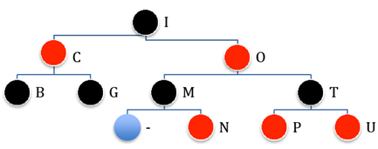
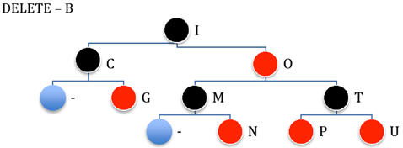
RBT OPERATION
DELeTION EXAMPLE
Let the node to be deleted (B) be M, and its child (External Node) be C.
M and C are black, replace M with C.
Let’s denote C in its new position be N (it’s also called a double black), its parent be P, its sibling be S, SL be S’s left child and SR be S’s right child.
S, SL and SR are black, then recolor S as red.
Deleting string “LABCOMPUTING” (2)

Slide 36
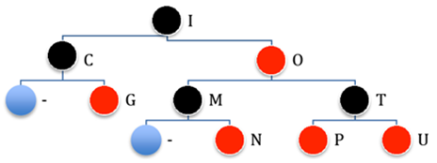
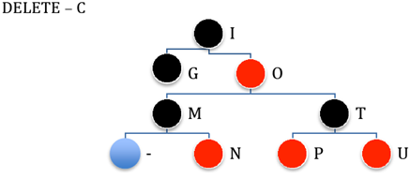
RBT OPERATION
DELeTION EXAMPLE
Deleting string “LABCOMPUTING” (3)
Let the node to be deleted (C) be M, and its child (G) be C.
M is black and C is red, replace it with C and recolor C with black.

Slide 37
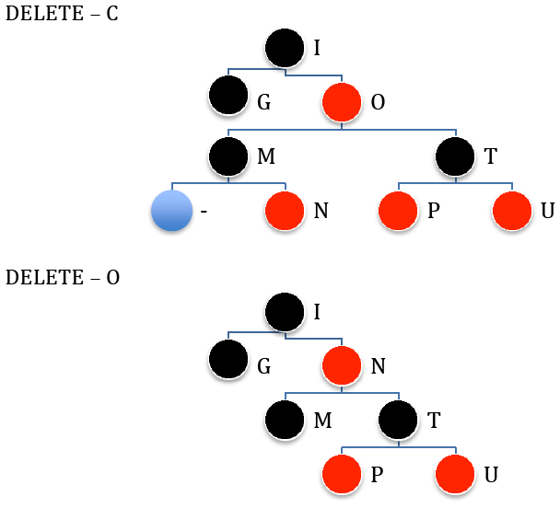
RBT OPERATION
DELeTION EXAMPLE
Deleting string “LABCOMPUTING” (3)
Let the node to be deleted (O) be M, and its child (N) be C.
M is red, then simply replace it with C

Slide 38
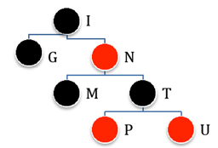
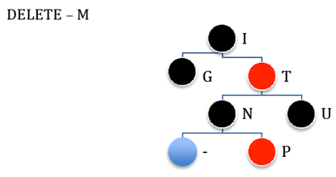
RBT OPERATION
DELeTION EXAMPLE
Let the node to be deleted (M) be M, and its child (External Node) be C.
M and C are black, replace M with C.
Let’s denote C in its new position be N (it’s also called a double black), its parent be P, its sibling be S, SL be S’s left child and SR be S’s right child.
S is black and SL or SR is red, then single rotate
Deleting string “LABCOMPUTING” (4)

Slide 39
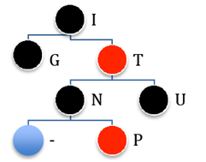
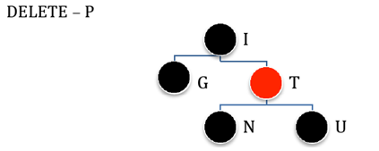
RBT OPERATION
DELeTION EXAMPLE
Deleting string “LABCOMPUTING” (4)
Let the node to be deleted (P) be M, and its child (External Node) be C.
M is a Leaf and no Sibling, then simply delete M

Slide 40
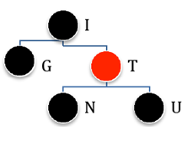
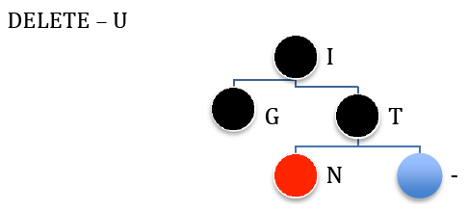
RBT OPERATION
DELeTION EXAMPLE
Let the node to be deleted (U) be M, and its child (External Node) be C.
M (it’s also called a double black), its parent be P, its sibling be S, SL be S’s left child and SR be S’s right child.
S, SL and SR are black, then recolor S as red.
Double black change place to P, because P (T) is red, simply recolor it to black.
Deleting string “LABCOMPUTING” (4)

Slide 41
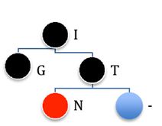
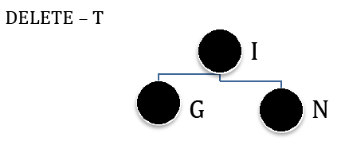
RBT OPERATION
DELeTION EXAMPLE
Deleting string “LABCOMPUTING” (4)
Let the node to be deleted (T) be M, and its child (N) be C.
M is black and C is red, replace it with C and recolor C with black.

Slide 42
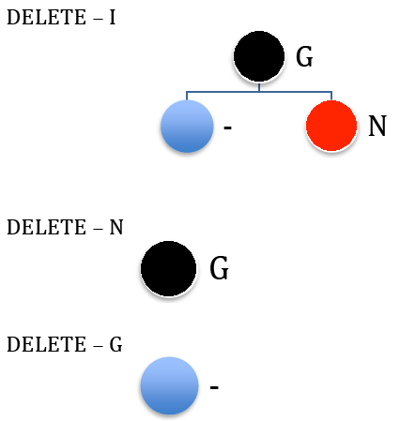
RBT OPERATION
DELETION EXAMPLE
Deleting string “LABCOMPUTING” (5)
Let the node to be deleted (N) be M, and its child (External Node) be C.
M is black and C is red, replace it with C and recolor C with black.

Slide 43
References
Reema Thareja. 2014. Data structures using C. Oxford University Press. New Delhi. ISBN:9780198099307. Chapter 11
Thomas H. Cormen, Charles E. Leiserson, Ronald L. Rivest, & Clifford Stein. (2009). Introduction to Algorithms. 03. The MIT Press. London. ISBN: 9780262033848. Chapter 13
Red Black Tree, http://www.cs.usfca.edu/~galles/visualization/RedBlack.html

